Slide 1

HWRF Initialization Overview
HWRF v3.7a Tutorial
Nanjing, China, December 1, 2015
Ligia Bernardet
NOAA ESRL Global Systems Division, Boulder CO
University of Colorado CIRES , Boulder CO

Slide 2
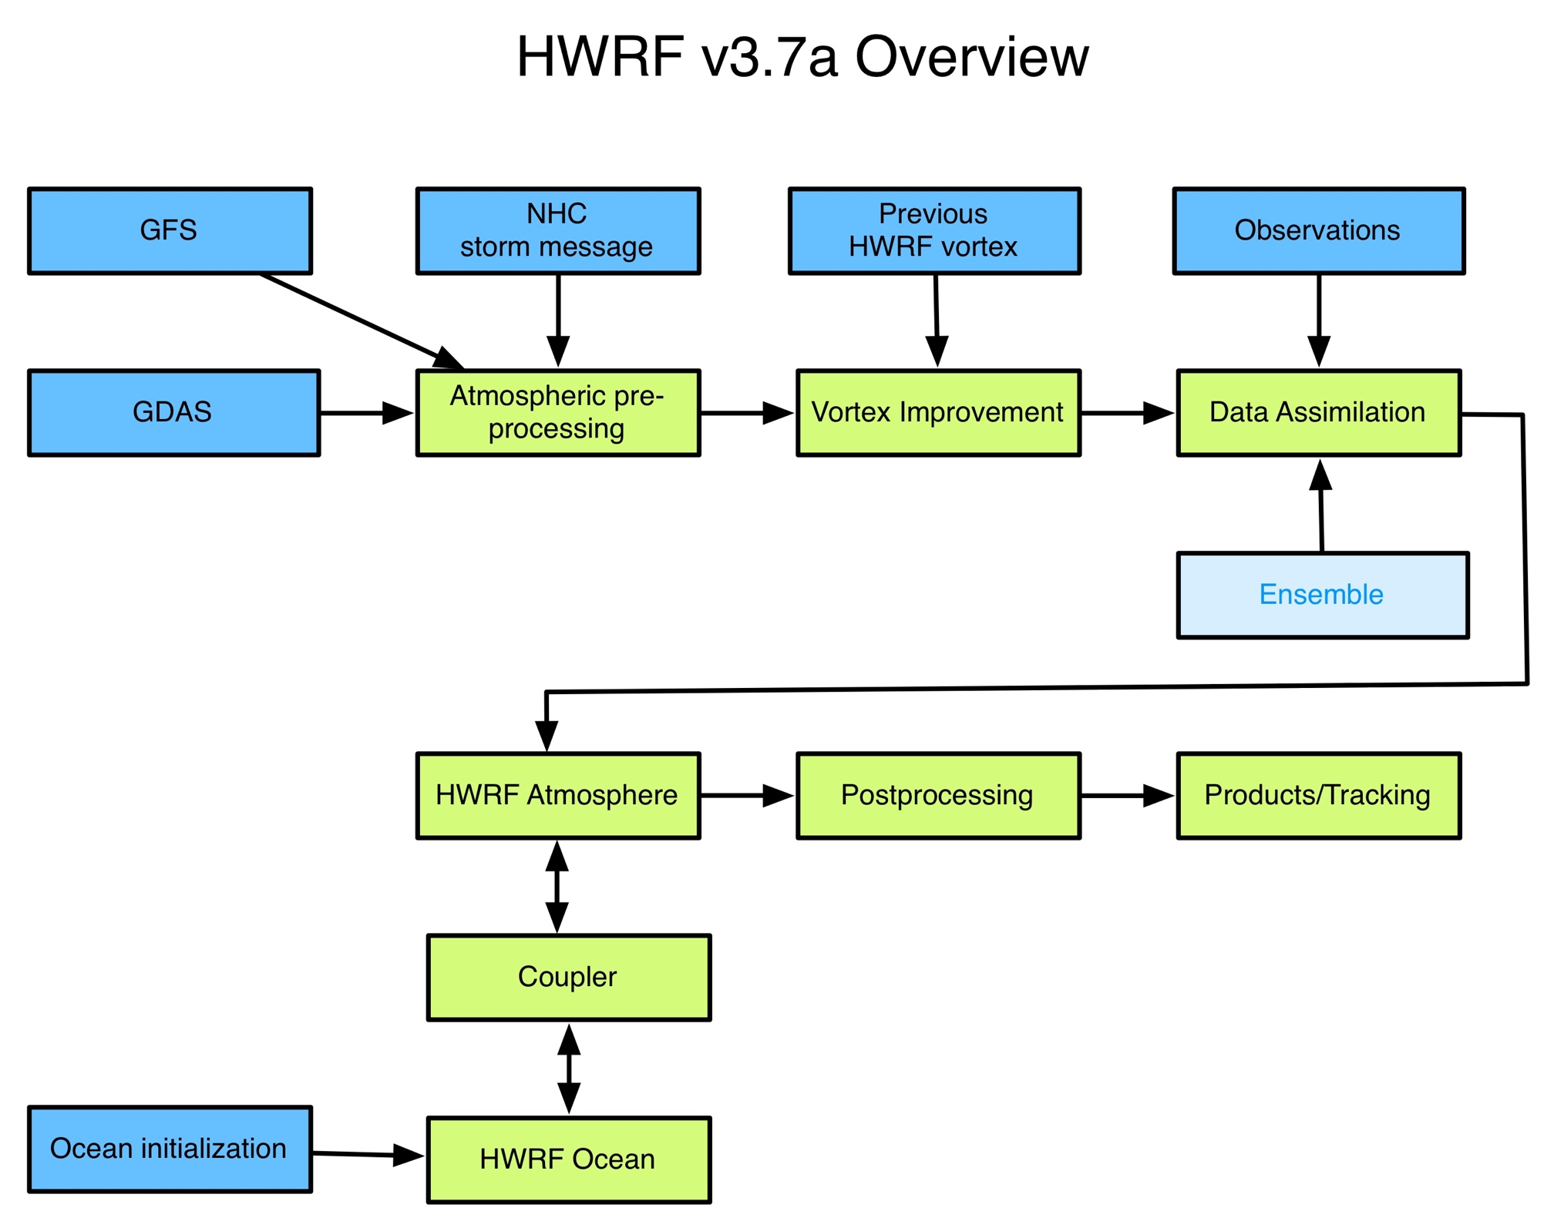
GFS – Global Forecast System
Used for lateral boundary conditions and initial conditions for parent
GDAS – Global Data Assimilation System (6-h forecast of previous 6-h cycle)
Used for initialization of nests
GFS ensemble
Used for hybrid DA (not in this tutorial)

Slide 3
Domain location
Location (10*lat , 10*lon)
HWRF is only launched when a TC Vital message is issued
Parent domain location depends on the storm location and 72-h projection
E. g., JTWC 07W SOULIK 20130709 1200 203N 1381E 285 057 …
Domain center latitude (CENLA)
if STORM_LAT < 15.0 then CENLA=15.0
if 15.0 ≤ STORM_LAT ≤ 25.0 then CENLA=STORM_LAT
if 25.0 < STORM_LAT < 35.0 then CENLA=25.0
etc.
Domain center longitude (CENLO)
The domain center longitude is the average of storm center and the 72-h forecast
If 72-h forecast absent, d01 center is 20 W from storm center
To assure that the domain center is separated from the storm center by at most 5 degrees, the following procedure is followed:
if CENLO > STORM_LON+5 then CENLO= STORM_LON + 5 if CENLO < STORM_LON- 5 then CENLO= STORM_LON - 5
The d02 and d03 are centered on the storm
Direction(º); speed (dm/s)

Slide 4
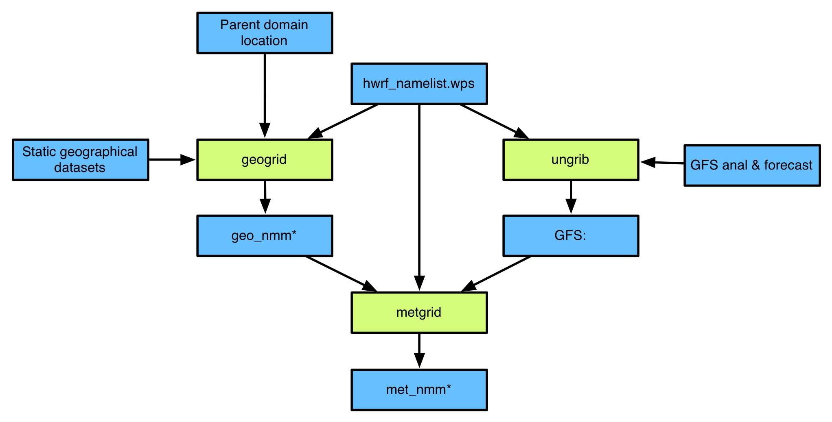
WRF Preprocessing System (WPS)
Script determines domain location
Geogrid reads geographical static data (topography etc.) and interpolates them to WRF grids
Ungrib reads selected variables from global model analysis and forecast in GRIB format
Metgrid horizontally interpolates global model data to WRF grid
WRF Preprocessing System Users’ Guide (see Chapter 2):
http://www.dtcenter.org/HurrWRF/users/docs/users_guide/WRF-NMM_2015.pdf

Slide 5
Example of WPS namelist
Center of parent domain
&share
wrf_core = 'NMM',
max_dom = 3,
start_date = '2012-10-26_12:00:00',
end_date = '2012-10-31_12:00:00',
interval_seconds = 432000,
io_form_geogrid = 2, /
&geogrid
parent_id = 1,1,2,
parent_grid_ratio = 1,3,3,
i_parent_start = 1,99,12,
j_parent_start = 1,201,35,
e_we = 288, 142, 265
e_sn = 576, 274, 472
geog_data_res = '2m','2m','2m'
dx = 0.135,
dy = 0.135,
map_proj = 'rotated_ll',
ref_lat = 21.0,
ref_lon = 287.25,
geog_data_path = path_to_datasets/wps_geog,
opt_geogrid_tbl_path = path_to_geogrid_table,
&ungrib
out_format = 'WPS',
prefix = 'FILE’,/
&metgrid
fg_name = 'FILE',
io_form_metgrid = 2,
opt_metgrid_tbl_path = path_to_metgrid_table
WPS geographical dataset
(i,j) of SW corner of parent domain
Grid spacing of d01
Number of grid points in each domain

Slide 6
Additional files used in WPS
Geogrid table
Specifies source and interpolation method for geographical datasets
Ungrib table: Vtable
Specifies which fields to extract from GRIB file
Metgrid table
Specifies methods for interpolating parent model data to WRF grid

Slide 7
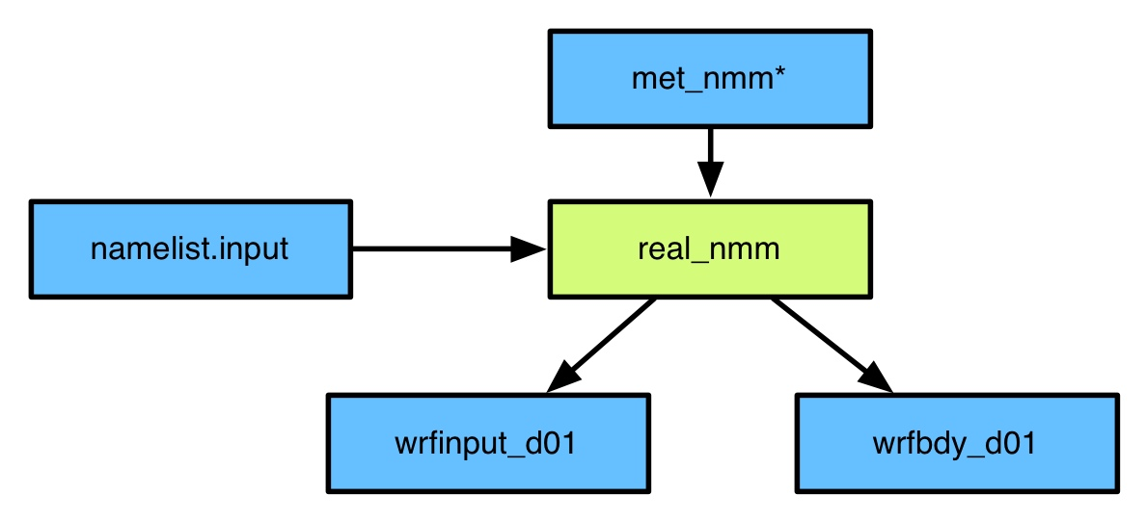
The real program
The real_nmm.exe program is used to vertically interpolate the global model data to the WRF levels
HWRF WP operational uses 43 levels. In this tutorial using 61 levels since DA is employed
Real_nmm.exe is also used to compute derived variables that are not present in the global data but are needed for WRF
Real_nmm.exe outputs initial & and boundary conditions that can be used to start WRF
For idealized simulations, program ideal.exe is used instead of real_nmm.exe
Real Users’ Guide (see Chapter 3):
http://www.dtcenter.org/HurrWRF/users/docs/users_guide/WRF-NMM_2015.pdf

Slide 8
The real/WRF namelist
&time_control
Begin, end time
Freq of boundary files
Freq of output
&domains
Timestep
Number of domains and dimensions
Grid spacing
Location of nests
Vertical levels
&physics
Cumulus, microphysics, radiation, PBL
Physics timesteps
Vortex tracker options
WRF also uses several lookup tables to expedite computations in the physical parameterizations
WRF Users’ Guide (see Chapter 4):
http://www.dtcenter.org/HurrWRF/users/docs/users_guide/WRF-NMM_2015.pdf

Slide 9
Review
Step 1: define location of parent domain
Geogrid: puts geographical static data in WRF grid
Ungrib & Metgrid: horizontally interpolate GFS data (in GRIB format) to WRF parent grid for initialization
Real: interpolate GFS data to WRF vertical levels
Once steps above are completed, a full set of ICs in the 3D parent WRF grid are available for starting the main forecast
The next steps are used to improve the vortex in these ICs

Slide 10
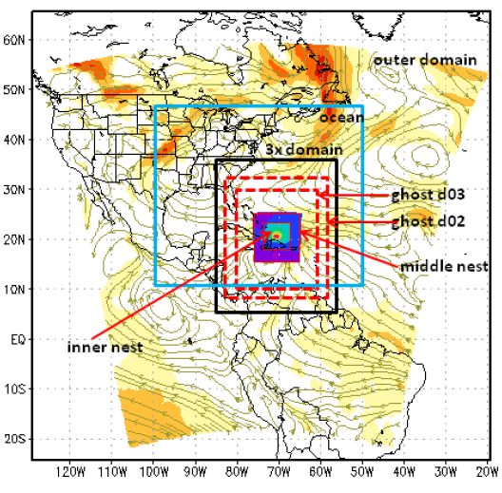
Preparing vortex initialization: Analysis
Step 1: WRF Analysis run (90 s WRF run)
Is used as a tool to downscale global data from real’s wrfinput_d01 file to HWRF d02, d03
Outputs “analyses” files for d02, d03, which are t=0 “WRF restart” files, containing variables needed by vortex relocation
Domains for WRF Analysis and HWRF forecast are identical
d01 - 18 km | d02 – 6 km | d03 - 2 km
80ºx80º | 12ºx12º | 7.1ºx7.1º

Slide 11
Preparing vortex initialization: Ghost
Step 2: WRF Ghost run (90 s WRF run)
Downscales global data from real’s wrfinput_d01 file to a large high-resolution domain for storm-scale data assimilation
Outputs “analyses” files for d02, d03, containing variables needed by DA package
Domains for HWRF forecast, WRF Analysis, WRF Ghost
 | d01 - 18 km | d02 – 6 km | d03 - 2 km
HWRF Forecast | 80ºx80º | 12ºx12º | 7.1ºx7.1º
WRF Analysis | 80ºx80º | 12ºx12º | 7.1ºx7.1º
WRF Ghost | 80ºx80º | 26ºx26º | 13ºx13º

Slide 12
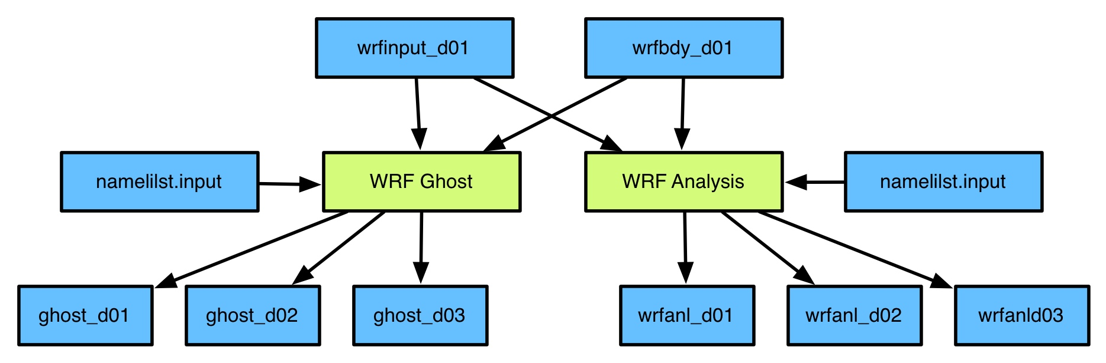
Summary of last Analysis & Ghost runs
WRF Ghost 90-s run
Downscales info from global model
Provide s first guess for storm-scale DA
WRF Analysis 90-s run
Downscales info from global model
d01,d02,d03 used as main input to vortex initialization procedure
d01 output used for identifying location of vortex in global model for removal

Slide 13

Vortex initialization: Stage 1
Cold Start?
Cycled Start?
OR
IF
Intensity < 14 ms⁻¹
OR
Previous 6 –h forecast NOT available
THEN
Exit Stage 1
IF
Intensity >14 ms⁻¹
AND
Previous 6 –h forecast IS available
THEN
Start vortex adjustment process by extracting HWRF vortex from previous forecast

Slide 14
Vortex initialization: Stage 2
Separate the GDAS first guess vortex from environmental flow
D02
9 km
D03
3 km
D02 + D03
Combine onto the 3X domain (20x20º 3-km)
Separate environment and vortex

Slide 15
Vortex initialization: Stage 3
Determine which vortex will be used for initializing HWRF and update it using TC Vitals
Cold Start?
OR
Cycled Start?
Int < 20 m/s
OR
Int >= 20 m/s
Update and use vortex from previous HWRF forecast
(Stage 1)
Update and use vortex from downscaled GDAS fields (Stage 2)
Use an axisymmetric bogus vortex

Slide 16
Vortex initialization: Stage 3
Put selected vortex in GDAS environment environmental flow
Final result: updated fields in d02 and d03 domains in the ghost d02 and d03 domains

Slide 17
GSI data assimilation (simplified)
Ghost D02
Ghost D03
Observations
First guess
bufrprep
Obs w/ altered QC
GSI
GSI
Analysis

Slide 18
GSI data assimilation (FGAT detail)
Ghost D02
Ghost D03
Observations
First guesses at
-3h, 0h, +3h
(WPS, Ghost, Analysis, real, and relocate are done for 3 time levels in order to use First Guess at Appropriate Time – FGAT)
bufrprep
Obs w/ altered QC
GSI
GSI
Analysis

Slide 19
Merge
Ensures consistency between domains by interpolating data from inner nests to their parent

Slide 20
Initial conditions for HWRF forecast
wrfinput_d01
wrfinput_d02
wrfinput_d03
GFS analysis w/ merged info from all domains
GDAS background w/
vortex improvement,
GSI data assimilation, and merged info from all domains

Slide 21
Differences with respect to operations
The steps described here, and which will be taught in the practical session, make it possible to use GFS/GDAS analyses and forecasts in GRIB format to initialize WRF
In operations, HWRF also utilizes GFS/GDAS forecasts in binary format. These are spectral coefficients output directly from the global model, in the global model native vertical grid
In operations, DA is only run routinely for the AL basin
In operations an ensemble (global or regional) is used to create flow-dependent background error covariances for data assimilation. In this tutorial, the ensemble will not be employed
In operations, WP is run with 42 levels. In this tutorial, will use 61 to improve DA
Please contact our user support if you are interested in learning more about these other capabilities of HWRF

Slide 22
Upcoming talks
In the next talks, you will learn more about
Data assimilation with GSI
The algorithm used for vortex initialization

Slide 23
Thank you for your interest!
You can…
Ask questions during the tutorial
Visit our website: http://www.dtcenter.org/HurrWRF/users
HWRF v3.7a Users Guide: http://www.dtcenter.org/HurrWRF/users/docs/users_guide/HWRF_v3.7a_UG.pdf
Scientific Documentation: http://www.dtcenter.org/HurrWRF/users/docs/scientific_documents/HWRF_v3.7a_SD.pdf
WRF-NMM Users Guide:
http://www.dtcenter.org/HurrWRF/users/docs/users_guide/WRF-NMM_2015.pdf
Contact me later: ligia.bernardet@noaa.gov
Reach our user helpdesk: hwrf-help@ucar.edu

